Slide 1
Spring AOP Example – Pointcut , Advisor
Advice
Indicate the action to take either before or after the method execution.
Pointcut
Indicate which method should be intercept, by method name or regular expression pattern.
Advisor
Group ‘Advice’ and ‘Pointcut’ into a single unit, and pass it to a proxy factory object.
Class A
Method1
Method2
Method3

Slide 2
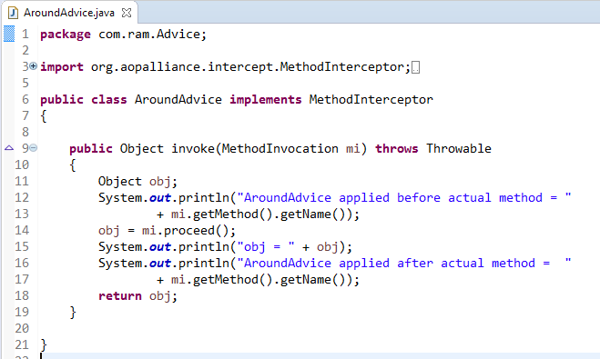
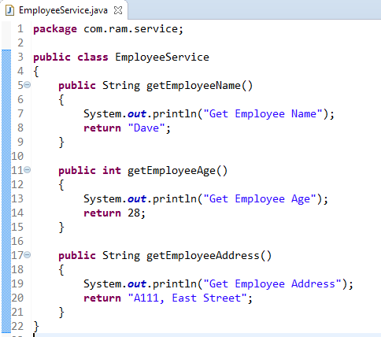
Spring AOP Example – Pointcut , Advisor
How to apply AroundAdvice only for the method getEmployeeAge() and don’t apply for other methods?
We can match the method via following two ways :
Name match
Regular repression match

Slide 3
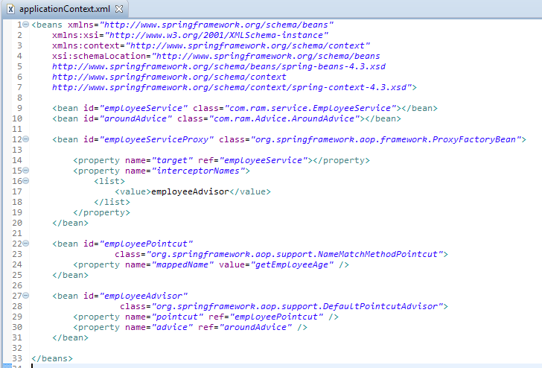
Spring AOP Example – Pointcut , Advisor
Intercept a getEmployeeAge() method via ‘pointcut’ and ‘advisor’. Create a NameMatchMethodPointcut pointcut bean, and put the method name you want to intercept in the ‘mappedName‘ property value.
Create a DefaultPointcutAdvisor advisor bean, and associate both advice and pointcut.

Slide 4
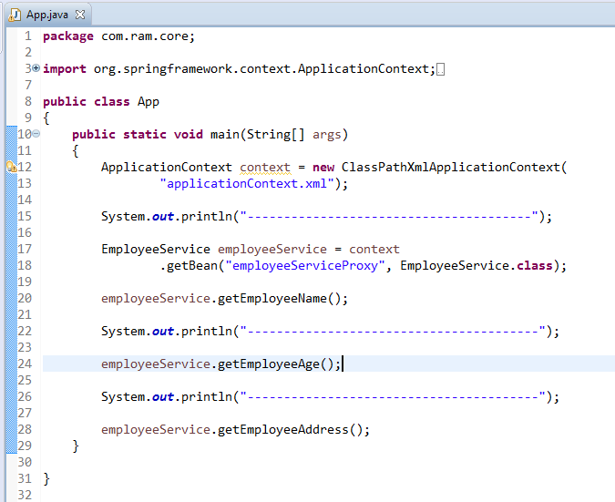
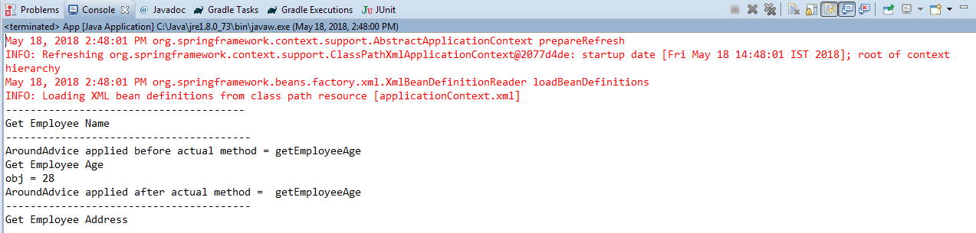
Spring AOP Example – Pointcut , Advisor

